Slide 1
Time-to-Event Data
Survival Data
Lifetime data

Slide 2
Lifetime / Response Time Data
Reliability Theory
  Engineering
Survival Analysis
  Biostatistics
  Actuarial Science
Event-History Analysis
  Social Sciences

Slide 3
Similarities
Multiple Failure Modes
System Reliability
Accelerated testing
Recurrence data

Slide 4
Example 1.1.1
Demographers and social scientists are interested in the duration of certain life "states" for humans.
Consider, for example, marriage and, in particular, the marriages formed during the year 2009 in a particular country.
  Then the lifetime of a marriage would be its duration; a marriage may end due to annulment, divorce, or death.

Slide 5
Economists and demographers study the length of time people are in the work force (Kpedekpo, 1969).
Employers are concerned with the length of time employees work before changing jobs.
Mental health officials use tables of length of stay in facilities to predict patient load.
Businessmen wish to know the shelf life of goods and the time it takes inventory to turn over; for example, one manufacturer wanted to know the distribution of time from manufacture to installation of a major appliance.

Slide 6
Example 1.1.2
Manufactured items with mechanical or electronic components are often subjected to life tests in order to obtain information on their durability.
This involves putting items in operation, often, in a laboratory setting, and observing them until they fail.
It is common here to refer to the lifetimes as "failure times," since when an item ceases operating satisfactorily, it is said to have "failed.".

Slide 7
Wildlife managers use mortality tables to predict wildlife population sizes and determine hunting seasons.
Hoadley (1970) studied the length of time telephones remain disconnected in vacant quarters in order to determine which telephones to remove for use elsewhere and which to leave in for the next customer.
Kosambi (1966) proposed that knowledge of the distribution of the time that coins remain in circulation can help the mint plan production.

Slide 8
The success of medical treatments for certain diseases is measured by the length of patient survival (Gross and Clark, 1975).
The distribution of time from prison release to committing a crime measures the success of prison programs.
Potency of some pesticides (and chemicals) is bioassayed by observing the times to death (or other reaction) of a sample of insects or animals.
Life insurance companies determine premiums from mortality tables.

Slide 9
The definition of lifetime includes a time scale and time origin, as well as a specification of the event (e.g., failure or death) that determines lifetime.
In some settings it is difficult to say precisely when the event occurs: for example, “the appearance of a tumor”.
The time scale is not always real or chronological time, especially where machines or equipment are concerned.
For example, miles driven might be used as a time scale with motor vehicles, and number of page s of output for a computer printer or photocopier.

Slide 10
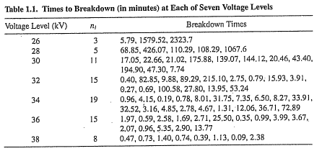
Example 1.1,5. Nelson (1972a)
Table 1.1 describes the results of a life test experiment in which specimens of a type of electrical insulating fluid. were subjected. to a constant voltage stress.
The length of time until each specimen failed, or "broke down," was recorded.

Slide 11
Remarks
The previous experiment was run long enough to observe the failure of all the insulation specimens tested.
Sometimes it may take a long time for all items to fail, and it is deemed necessary to terminate a study before this can happen.
In this case, the lifetimes of certain items are censored.
Censoring arises in lifetime data in a variety of ways.

Slide 12
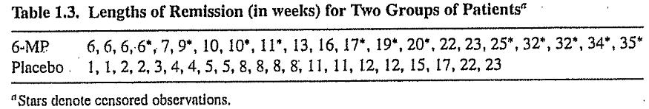
Example 1.1.7
Gehan (1965) and others have discussed the results of a clinical trial reported by Freireich et al. (1963), in which the drug 6-mercaptopurine (6-MP) was compared to a placebo with respect to the ability to maintain remission in acute leukemia patients.
Table 1.3 gives remission times for two groups of 21 patients each, one group given the placebo and the other the drug 6-MP.
The starred observations are censoring times; for these patients, the disease was still in a state of remission at the end of the study.

Slide 13
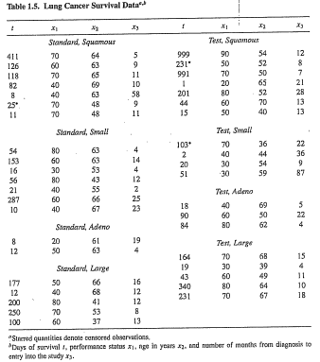

Slide 14
Some Considerations regarding Lifetime Data Collection

Slide 15
Reliability data arise from a number of different sources
  laboratory life tests,
  field-tracking studies, and
  warranty databases
The definition of lifetime includes a time scale and time origin, as well as a specification of the event (e.g., failure or death) that determines lifetime.

Slide 16
Time Scale
The time scale is not always real or chronological time, especially where machines or equipment are concerned. For example, miles driven might be used as a time scale with motor vehicles, and number of pages of output for a computer printer or photocopier.
In some context, it could be operating hours, or more generally, some measure of exposure.

Slide 17
Time origin
One has to determine if exposure begins on the date of manufacture, or date of installation, or date of purchase, etc.
In some settings it is difficult to say precisely when the measure of exposure commences: for example, the “appearance of a tumor”.

Slide 18
Failure
For many products, failure is catastrophic, and it is clear when failure occurs.
For some products, performance slowly degrades, and there is no clear end of life. One can then define that a failure occurs when performance degrades below a specified value.
Of course, one can analyze data according to each of a number of definitions of failure.

Slide 19
Types of Data

Slide 20
Some popularly used jargon
We are following subjects over time, and that data collection effort is typically called a study.
During the study period, subjects are enrolled and data are collected for a while, called the subject's follow-up period, or if you prefer, the period during which the subject was under observation.
Censoring is defined as when the failure event occurs and the subject is not under observation.
  Think of censoring as being caused by a censor standing between you and reality, preventing you from seeing the exact time of the event that you know occurs.

Slide 21
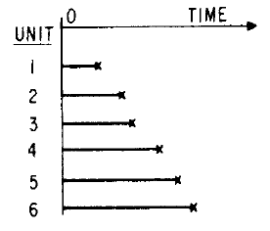
Complete
Lifetime of each sample unit is recorded from start to finish.

Slide 22
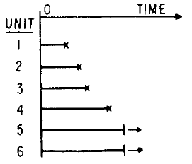
Singly Time Censored
Sometimes when life data are analyzed, some units are unfailed. and their failure times are known only to be beyond their present running times.
Such data are said t o be censored on the right.
Unfailed units are called run-outs, survivors, removals, and suspended units.

Slide 23
Similarly, a failure time known only to be before a certain time is said to be censored on the left.
If all unfailed units have a common running time and all failure times are earlier the data are said to be singly censored on the right.
Singly censored data arise when units are started on test together and the data are analyzed before all units fail.
Time censored data are also called Type I censored.

Slide 24
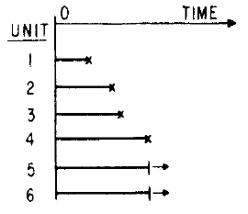
Singly Failure Censored
Data are singly failure censored (or Type II censored) if the study is stopped when a specified number of failures occurs; the time to that fixed number of failures being random.

Slide 25
Much data censored on the right have differing running times intermixed with the failure times.
Such data are called multiply censored (also progressively, hyper- and arbitrarily censored).
Multiply censored data usually come from field studies, because units go into service at different times and have different running times when the data are recorded.
Such data may be time censored (running times differ from failure times) or failure censored(running times equal failure times).

Slide 26
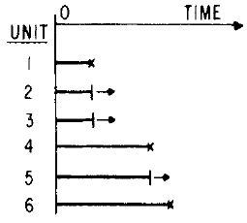
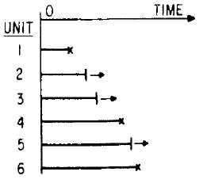
Multiply Time Censored
Multiply Failure Censored

Slide 27
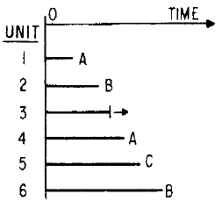
Competing Failure Modes

Slide 28
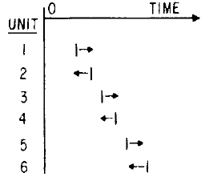
Quantal-response data
Also called sensitivity, probit, and all-or-nothing response data.

Slide 29
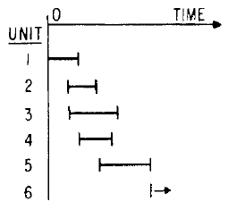
Interval Data
When units are inspected for failure more than once, one knows only that a unit failed in an interval between inspections.
Such data can also contain right and left censored observations

Slide 30
MODELS FOR CONTINUOUS FAILURE-TIME PROCESSES
(or Describing the distribution of “time to event”)

Slide 31
Characterizing “Time to Event”
Let T denote a nonnegative, continuous random variable describing the failure time of a unit or system.
The probability distribution for failure time T can be characterized by a
  cumulative distribution function;
  probability density function;
  survival function; or
  hazard function

Slide 32
Cumulative distribution function (cdf)
The cumulative distribution function (cdf) of T, F(t) = Pr(T < t), gives the probability that a unit will fail before time t.
Alternatively, F(t) can be interpreted as the proportion of units in the population (or taken from some stationary process) that will fail before time t.

Slide 33
Probability Density Function (pdf)
The probability density function (pdf) for a continuous random variable T is defined as the derivative of F(t) with respect to t:
f(t) = dF(t)/dt.
The pdf can be used to represent relative frequency of failure times as a function of time.

Slide 34
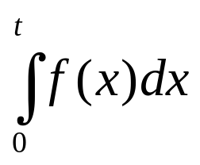
Probability Density Function (pdf)
Although pdf is less important than the other functions, it is used extensively in the development of technical results.
The cdf at t is computed as the area under the pdf from 0 to t, giving the probability of failing before t. That is, F(t) =

Slide 35
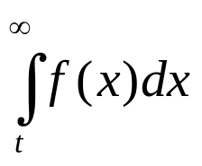
Survival Function (sf)
The survival function (sf), also known as the reliability function, is the complement of the
cdf, S(t) = Pr(T > t) = 1 - F(t) = , and gives the probability of surviving beyond time t.

Slide 36
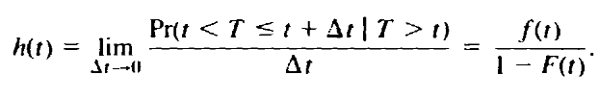
Hazard Function
The hazard function (hf), also known as the hazard rate, the instantaneous failure rate function, the mortality rate function, the force of mortality and by other names, is defined by

Slide 37
Hazard Function
The hazard function specifies the instantaneous rate of death or failure at time given that the individual survives up to t; h(t)∆t is the approximate probability of death in [t, t + ∆t), given survival up to t.
Another interpretation: in the short time ∆, from t to t + ∆, a proportion h(t)∆ of the population that reached age t fails.

Slide 38
Hazard Function
Thus the hazard function is a measure of proneness to failure as a function of age,i.e. it indicates the risk of failure as a function of age or time.
Unit of measurement: fraction failed per unit time

Slide 39
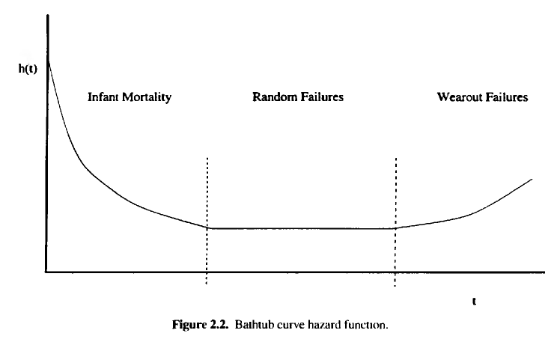

Slide 40

Cumulative Hazard Function

Slide 41



Some relationships

Slide 42
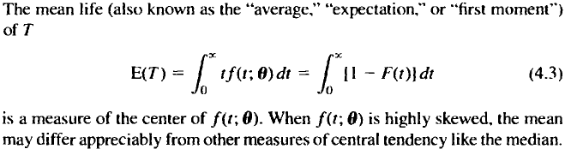
Some Scalar Characterizations
The mean is sometimes, but not always, one of the distribution parameters.
For some pdfs, the value of the integral will be infinite, then it is said that the mean of T "does not exist.“
When T is time to failure, the mean is sometimes referred to as the MTTF, for mean time to failure.

Slide 43
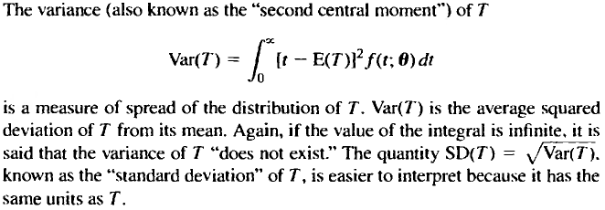
Some Scalar Characterizations

Slide 44
Some Scalar Characterizations
The unitless quantity γ₂= SD(T)/E(T), known as the "coefficient of variation” of T, is useful for comparing the relative amount of variability in different distributions.
The quantity 1/γ₂ = E(T)/SD(T) is sometimes known as the "signal-to-noise ratio."

Slide 45
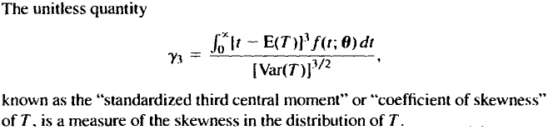
Some Scalar Characterizations
When a distribution is symmetric, γ_{з} = 0.
It is, however, possible to have γ_{з} = 0 for a distribution that is not perfectly symmetric .

Slide 46
Some Scalar Characterizations
The pth quantile of F is the smallest time t_{p} such that Pr(T ≤ t_{p}) = F(t_{p}) ≥ p, where 0 < p < 1.
OR
t_{p}= inf{x: F(x) ≥ p }

Slide 47
Some Scalar Characterizations
When F(t) is strictly increasing there is a unique value t_{p} that satisfies F(t_{p}) = p, and we write t_{p} = F⁻¹(p).
When F(t) is constant over some intervals, there can be more than one solution t to the equation F(t) ≥ p.
Taking t_{p} equal to the smallest t value satisfying F(t) ≥ p is a standard convention.

Slide 48
The analysis of survival data can take one of three forms
  nonparametric,
  semiparametric, and
  parametric
depending on what we are willing to assume about the form of the survivor function and about how the survival experience is affected by covariates.

Slide 49
SOME PARAMETRIC MODELS

Slide 50



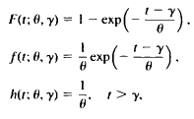
The Exponential Distribution
Another parametrization:

Slide 51
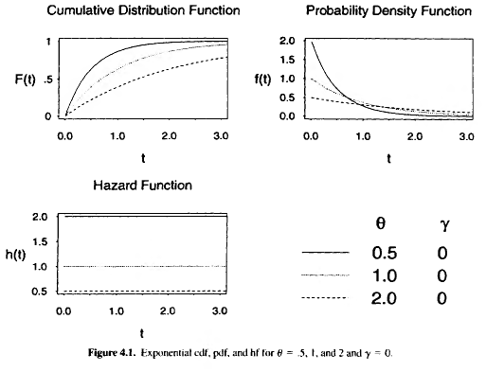
The Exponential Distribution

Slide 52
The Exponential Distribution
For integer m > 0, E[(T - γ)^{m}] = m!θ θ^{m}.
Thus the mean and variance of the exponential distribution are, respectively, Е(T) = γ + θ and Var(T) = θ².
The p quantile of the exponential distribution is t_{p} = γ - log(1-p) θ.

Slide 53
The Exponential Distribution
has the important characteristic that its hf is constant (does not depend on time t).
A constant hf implies that, for an unfailed unit, the probability of failing in the next small interval of time is independent of the unit's age.
Physically, a constant hf that the population of units under consideration is not wearing out or aging.

Slide 54
The Exponential Distribution
Under very special circumstances, the exponential distribution may be appropriate for the times between system failures, arrivals in a queue, and other interarrival time distributions.
Specifically, the exponential distribution is the distribution of interval times of a homogeneous Poisson process.

Slide 55
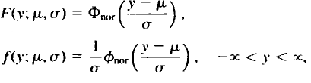
The Normal Distribution

Slide 56
The Normal Distribution
For integer m > 0, Е(T - μ)^{m} = 0 if m is odd and Е(T - μ)^{m} = m! σ^{m} /[2^{m/2}(m/2)!] if m is even.
From this, the mean and variance of the normal distribution are, respectively, E(T) = μ and Vаг(T) = σ².
The p quantile of the normal distribution is t_{p} = μ+ Ф⁻¹(р)σ, where Ф⁻¹(р) = z_{p} is the p quantile of the standard normal distribution.

Slide 57
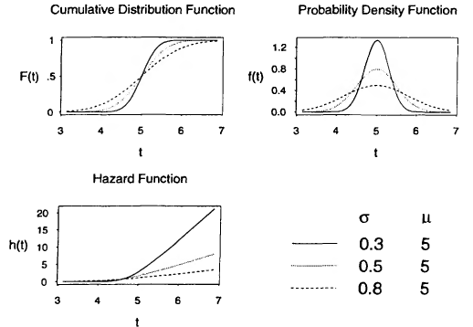
The Normal Distribution

Slide 58

Log-Normal Distribution
The lifetime T is said to be log-normally distributed if Y = log T is normally distributed, say with mean µ and variance σ².
Then T has a pdf given by

Slide 59
Log-Normal Distribution
The parameter µ is called the log mean and may have any value: it is the mean of the log of life-not of life.
The parameter σ is called the log standard deviation and must be positive: it is the standard deviation of the log of life-not of life.
µ and σ are not “times” like t; instead they are dimensionless pure numbers.

Slide 60
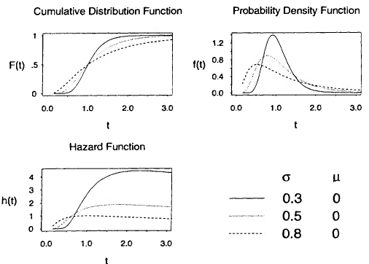
Log-Normal Distribution

Slide 61
Log-Normal Distribution
This distribution is often useful if the range of the data is several powers of 10.
It is often used for economic data, data on response of biological material to stimulus, and certain types of life data, for example, metal fatigue and electrical insulation life.

Slide 62
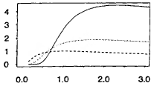
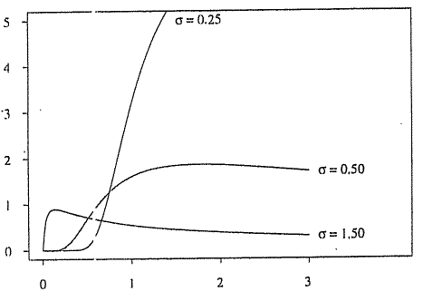
Log-Normal Distribution
The lognormal distribution is widely used to describe time to fracture from fatigue crack growth in metals.
The lognormal h(t) starts at 0, increases to a point in time, and then decreases eventually to zero.
For large σ, h(t) reaches a maximum early in life and then decreases.
For this reason, the lognormal distribution is often used as a model for a population of electronic components that exhibits a decreasing hf.

Slide 63
Log-Normal Distribution
The shape of the lognormal h(t) can be used to model some situations, for example, when a population consists of a mixture of individuals who tend to have short and long lifetimes, respectively.
Examples include survival after treatment for some forms of cancer, where persons who are cured become long-term survivors, and the duration of marriages, where after a certain number of years the risk of marriage dissolution due to divorce tends to decrease.

Slide 64
Log-Normal Distribution
Some additional properties of the log-normal distribution:
  mean : exp(µ + σ²/2 ),
  Variance:[exp(σ²) - 1][exp(2µ + σ²)],
  median (t_{.50}) is exp(µ).

Slide 65
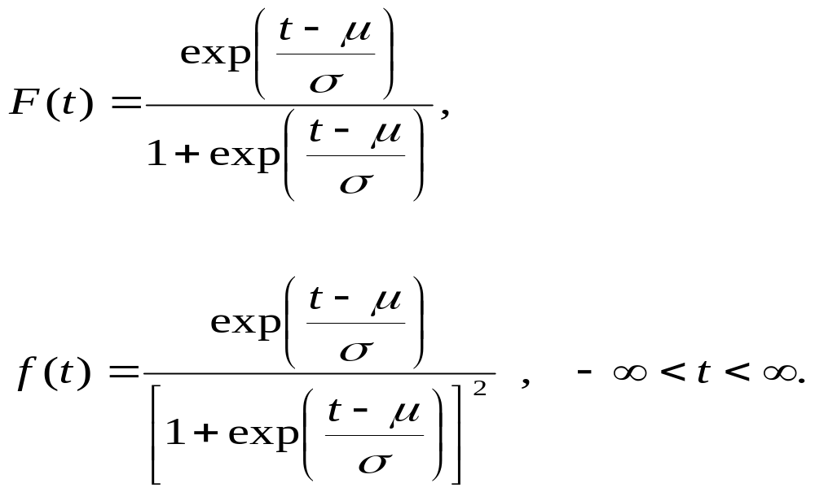
Logistic Distribution
The lifetime T is said to have a logistic distribution if its cdf and pdf are given, resp., by

Slide 66
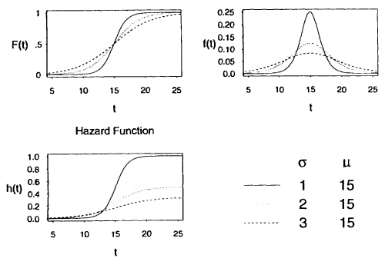
Logistic Distribution

Slide 67
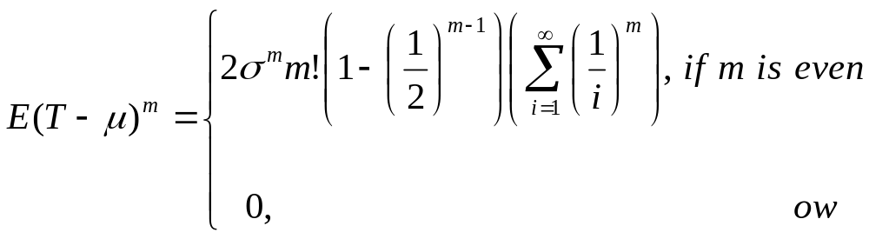
Logistic Distribution
For integer m > 0,
From this, we obtain E(T) = µ and Var(T) = σ² π³/3.
The pth quantile is t_{p}= µ + σ log[p/(1-p)]

Slide 68
Logistic Distribution
The shape of the logistic distribution is very similar to that of the normal distribution; the logistic distribution has slightly "longer tails.“
It would require an extremely large number of observations to assess whether data come from a normal or logistic distribution.
The main difference between the distributions is in the behavior of the hf in the upper tail of the distribution, where the logistic hf levels off, approaching l/σ for large t.
For some purposes, the logistic distribution has been preferred to the normal distribution because its cdf can be written in a simple closed form.
With modern software, however, it is not any more difficult to compute probabilities from a normal cdf.

Slide 69
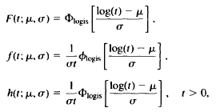
Loglogistic Distribution
When T has a loglogistic distribution, we indicate this by T ~ LOGLOGIS(µ,σ).
If T~ LOGLOGIS(µ,σ) then Y = log(T) ~ LOGIS(µ,σ).

Slide 70
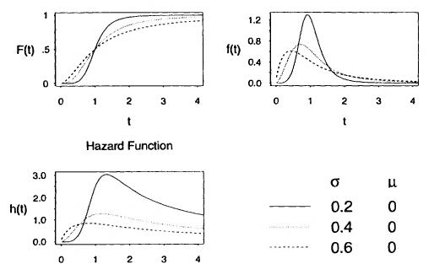
Loglogistic Distribution

Slide 71
Loglogistic Distribution
The median t_{p} = e^{µ} is a scale parameter and σ is a shape parameter.
For integer m > 0, ET^{m} =e^{mµ}Γ(1+mσ) Γ(1-mσ).
For values of σ ≥ 1, the mean of T does not exist.
For values of σ ≥ 1/2, the variance of T does not exist.
The p quantile is t_{p}= exp{µ + σ log[p/(1-p)]}.

Slide 72
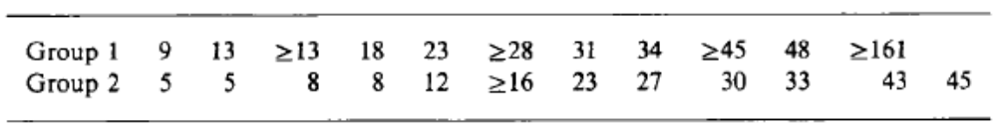
Remission times (weeks) for two groups of patients with acute myelogeneous leukaemia (AML), one receiving maintenance chemotherapy (Group 1) and the other not (Miller, 1981, p. 49).
^ indicates right-censoring.

Slide 73
Nonparametric analysis
Nonparametric analysis follows the philosophy of letting the dataset speak for itself and making no assumption about the functional form of the survivor function (and thus no assumption about, for example, the hazard, cumulative hazard).
The effects of covariates are not modeled, either-the comparison of the survival experience is done at a qualitative level across the values of the covariates.

Slide 74
Nonparametric analysis
Estimates of the median survival time are similarly not possible to obtain using nonsurvival tools.
The modern way of calculating the median is to turn to the calculation of survival probabilities and find the point at which the survival probability is 0.5.
Even the most simple analysis-never mind the more complicated regression models-will break down when applied to survival data.

Slide 75
Nonparametric analysis
Survival analysis is a field of its own.
Given the nature of the role that time plays in the analysis, much focus is given to the functions that characterize the distribution of the survival time:
  the hazard function,
  the cumulative hazard function, and
  the survivor function
being the most common ways to describe the distribution.

Slide 76
The Kaplan-Meier estimator
The estimator of Kaplan and Meier (1958) is a nonparametric estimate of the survivor function S(t), which is the probability of survival past time t or, equivalently, the probability of failing after t.
In Stata, the Kaplan-Meier estimate is obtained using the sts list command.
The Stata convention for handling a censoring that happens at the same time as a failure is to assume that the failure occurred before the censoring, and in fact, all Stata's st commands follow this rule.

Slide 77
The Kaplan-Meier estimator
sts graph graphs (among other things) the Kaplan-Meier estimate.
sts graph with the by() option can plot multiple survivor curves.
sts graph with the risktable option adds a table showing the number at risk beneath the survivor curve.
sts graph has other useful options for plotting Kaplan-Meier curves, including an option to add confidence bands and the noorigin option to specify that we wish the plotted survivor curve to begin at the first exit time instead of at t = 0.

Slide 78
The Nelson-Aalen estimator
The cumulative hazard function can be interpreted as the number of expected failures in (0, t) for a subject if failure were a repeatable event.
sts list with the cumhaz option gives the Nelson-Aalen estimator.
The cumhaz option is also valid for sts graph, in which case you are plotting the Nelson-Aalen cumulative hazard instead of the Kaplan-Meier survivor function.
sts graph can also be used to plot an estimate of the hazard function, h(t) by specifying option hazard

Slide 79
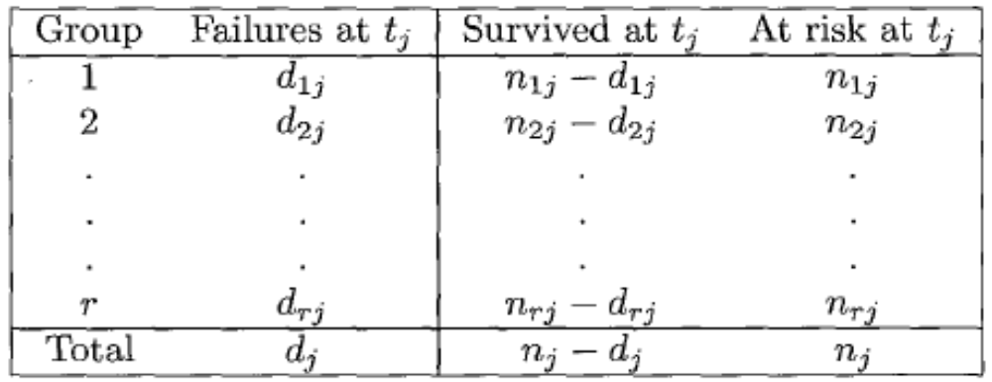
Tests of hypothesis
Suppose we are interested in comparing the survival experience of r groups.
Assume that, in all groups combined, there are k distinct failure times t₁, t₂, … t_{k}.
Further assume that, at failure time t_{j}, there are n_{j} subjects at risk, of which d_{j} fail and n_{j} - d_{j} survive.

Slide 80
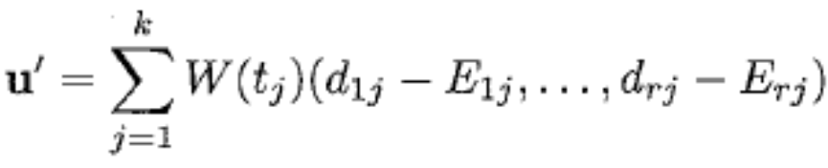
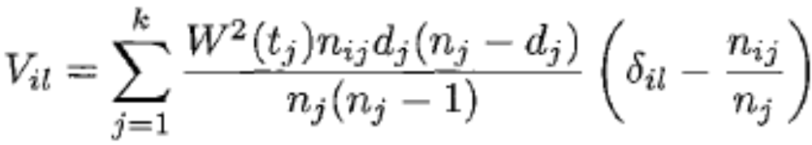
Tests of hypothesis
The expected number of failures in group i at time t_{j}, under the null hypothesis of no difference in survival among the r groups, is E_{ij} = n_{ij}d_{j}/n_{j}.
Define the vector u and the matrix V [=V_{il}] by
and
where i = 1,...,r ; l = 1,...,r; and δ_{il} = 1 if i =l and 0 ow.

Slide 81
Tests of hypothesis
The chi-squared test statistic is calculated as a quadratic form u'V⁻¹u and is distributed as χ² with r - 1 degrees of freedom under the null.
The weight function W(t_{j}) is what characterizes the different types of the tests computed by sts test and is defined as a positive function equal to zero when n_{ij} is zero.
The test statistic is constructed by combining the information from the contingency tables obtained at every failure time, and consequently, the test takes into account the entire survival experience and not just a specific point in time.

Slide 82
Tests of hypothesis
To form formal tests of hypothesis for the equality of survivor functions across groups, you can use the sts test command.
sts test will allow you to test the equality of survivor functions using one of several available nonparametric tests, namely,
  the log-rank,
  Wilcoxon,
  Peto-Peto-Prentice. and
  generalized Fleming-Harrington tests.

Slide 83
Tests of hypothesis
All these tests are appropriate for testing the equality of survivor functions across two or more groups.
  These tests do not test the equality of the survivor functions at a specific time point.
  Instead, they are global tests in the sense that they compare the overall survivor functions.
  They do this by comparing (at each failure time) the expected versus the observed number of failures for each group and then combining these comparisons over all observed failure times.

Slide 84
Tests of hypothesis
These tests differ only in respect to how they weight each of these individual comparisons that occur at each failure time when combining these comparisons to form one overall test statistic.
for sts test the null hypothesis is
H_{o}: h₁(t) = h₂(t) = · · · = h_{r}(t)
and the different tests vary in power according to how H₀ is violated.

Slide 85
The log-rank test
sts test varname, performs logrank test.
varname should be a variable taking on different values for different groups, such as 1, 2, 3, ... , or any distinct set of values.
For the log-rank test, W(t_{j}) = 1 when n_{ij} is nonzero.
For example, the log-rank test is most powerful when the hazards are not equal but instead are proportional to one another.

Slide 86
The Wilcoxon test
sts test varname, wilcoxon will perform the generalized Wilcoxon test of Breslow (1970) and Gehan (1965) .
The Wilcoxon test is also a rank test and is constructed in the same way as the log-rank test, except that for this test we set W(t_{j}) = n_{j}
  I.e. it places more weight to tables at earlier failure times-when more subjects are at risk-than to tables for failures later in the distribution.

Slide 87
The Wilcoxon test
The Wilcoxon test is preferred to the log-rank test when the hazard functions are thought to vary in ways other than proportionally.
However, there is a drawback.
  Because of this weighting scheme, the Wilcoxon test can prove unreliable if the censoring patterns differ among the test groups.

Slide 88
Stratified tests
In a stratified test, we perform the test separately for different subgroups of the data and then combine the test results into one overall statistic.
For instance, we might be testing that Group A had similar survival experiences as Group B, but then we might decide to stratify on sex, so we would test
  1) that females in Group A had similar survival as did females in Group B and
  2) that males in Group A had similar survival as did males in Group B.

Slide 89
Stratified tests
Why do this?
Because perhaps we think the survival experiences of males and females differ.
If Group A had more females than Group B and we just compared the two groups, then we could be misled into thinking there is a difference due to A and B.
Syntax: sts test grp_var, logrank strata(strat_var)
Notes:
. gen agegrp = 1
. replace agegrp = 2 if age>65

Slide 90
The Cox proportional hazards model

Slide 91
Introduction
Since our main variable of interest is (survival) time, we might be lead into thinking of survival models as either:
t_{j} = β₀+ β₁ x_{j} + ε_{j}
or
ln(t_{j}) = β₀+ β₁ x_{j} + ε_{j},
where ε_{j} is suitably distributed.
These days, people seldom write models in this form.

Slide 92
Introduction
Instead, they write
h_{j}(t) = g(t, β₀+ x_{j} β)
that is, the hazard-the intensity with which the event occurs-for person j is some function g( ) of β₀+ x_{j} β, where we now allow for the presence of multiple predictors via the row vector x_{j}, in which case β is a column vector of regression coefficients.
The distributional assumption we make for ε_{j} is now wrapped up in the hazard function that we choose.

Slide 93
Introduction
So, why should we write our models in this form?
The idea here is to write the model as
h_{j}(t) = somefunction(h₀(t), β₀+ x_{j} β)
where h₀(t) is called the baseline hazard.
That is, the hazard subject j faces is somefunction( ) of the hazard everyone faces, modified by x_{j}.

Slide 94
Introduction
A particularly popular way to parameterize these models is
h_{j}(t) = h₀(t) exp(β₀+ x_{j} β).
These are called proportional hazards models.
They are proportional in that the hazard subject j faces is multiplicatively proportional to the baseline hazard, and the function exp() was chosen simply to avoid the problem of h_{j}( ) ever turning negative.

Slide 95
Parametric models
Any parametric survival model can be written in the hazard notation (although not necessarily the proportional-hazards notation).
All parametric models have a corresponding hazard function.

Slide 96
Parametric models
It turns out that several popular survival parametric models, which are naturally written in the form
ln(t_{j}) = β₀+ β₁ x_{j} + ε_{j},
have corresponding h( ) functions that naturally decompose into the
h₀(t) exp(β₀+ x_{j} β) notation.
  When that occurs, the model is said to have both a (log-) time metric and a proportional hazards metric formulation.

Slide 97
Semiparametric models
We will start with the same proportional hazards model that we started with in the parametric case:
h_{j}(t) = h₀(t) exp(β₀+ x_{j} β).
This time, however, rather than specifying a function for h₀(t), we will leave it unspecified, and it will cancel from our calculations when we perform the binary-outcome analyses at the individual failure times.
This method is called the Cox proportional hazards model.

Slide 98
The Cox proportional hazards model
The Cox proportional hazards regression model asserts that the hazard rate for the jth subject in the data is
h_{j}(t) = h₀(t) exp(x_{j} β).
The nice thing about this model is that h0 (t), the baseline hazard, is given no particular parameterization and, in fact, can be left unestimated.

Slide 99
The Cox proportional hazards model
The model makes no assumptions about the shape of the hazard over time-it could be
  constant,
  increasing,
  decreasing,
  increasing and then decreasing,
  decreasing and then increasing, or
  anything else you can imagine;
what is assumed is that, whatever the general shape, it is the same for everyone.

Slide 100
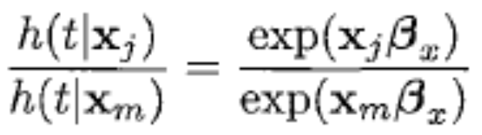
The Cox proportional hazards model
One subject's hazard is a multiplicative replica of another's; comparing subject j to subject m, the model states that
which is constant, assuming the covariates x_{j} and x_{m} do not change over time.

Slide 101
The Cox model has no intercept
The Cox model has no intercept.
The intercept is subsumed into the baseline hazard h₀(t), and mathematically, the intercept is unidentifiable from the data.
Pretend that we added an intercept to the model, thus
h_{j}(t| x_{j}) = h₀(t) exp(β₀+ x_{j} β)
={h₀(t) exp(β₀)} exp(x_{j} β)
We would now call {h₀(t) exp(β₀)} our new baseline hazard.

Slide 102
The Cox model has no intercept
The value of β₀ is undefined because any value works as well as any other - it would merely change the definition of h₀(t), which we do not define anyway.

Slide 103
Cox model with missing data
In the presence of missing data, stcox, as other Stata estimation commands, discards all observations that have a missing value in any of the specified covariates.
This method of handling missing data is known as listwise deletion, casewise deletion, or complete case analysis.
The major drawbacks of this method are potential loss of power to detect an association between an outcome and exposures due to reduced sample size and potential bias when the remaining observations are not representative of the population of interest.

Slide 104
Cox model with missing data
A popular way of handling missing data is multiple imputation (MI)
An appealing features of MI is that, similar to listwise deletion, it can be used with a wide variety of standard complete data methods.
Unlike listwise deletion, however, MI does not discard data, and thus it preserves all available information in the analysis.

Slide 105
Cox model with missing data
In Stata, you can perform MI using the mi command.
The imputation step is performed by using mi impute under the assumption of data missing at random (MAR) or missing completely at random (MCAR), which is when the reason for missing data does not depend on unobserved values.
The completed data analysis and pooling steps are combined in one step by the mi estimate prefix.

Slide 106
Interpreting coefficients
Exponentiated individual coefficients have the interpretation of the ratio of the hazards for a 1-unit change in the corresponding covariate.
For instance, if the coefficient of the variable age_in_years in some model is 0.18, then a 1-year increase in age increases the hazard by 20% because exp(0.18) = 1.20.
If the coefficient on the variable weight_in_kilos is -0.2231, then a 1 kg increase in weight decreases the hazard by 20% because exp( -0.2231) = 0.8.

Slide 107
Indicator variables
A variable equal to 0 or 1, where a value of 1 indicates that a certain condition has been met.
Syntax: stcox 0.var
Or
stcox 1.var

Slide 108
Categorical variables
Definition. A variable in which different values represent membership in different groups.
An indicator variable is just a special case of a categorical variable that has two groups, labeled 0 and 1.
Instead of including a categorical variable in the rnodel, indicator variables should be included in Stata by using factor-variable notation: stcox ... i.var
Stata, by default, will use the lowest value as the base level (omitted group) for the factor variable.

Slide 109
Other considerations
Interaction
Modeling group effects: fixed-effects, random-effects, stratification, and clustering
Cox models with survey data
Time-varying variables
Estimating the baseline cumulative hazard and survivor functions
Cox models with shared frailty
Diagnostics

Slide 110
Other issues
Parametric Models
Accelerated Failure Times
Power and sample size determination
Competing Risks

Slide 111
Next topic
Circular Data

